Slide 1

GuardianSync: Real Time Tracking with Face Recognition
Batch 2024-2025
Presenter: -
Ajay Kumar

Slide 2
Index
Introduction
Existing Solutions
Methodology
Modules
Result
Reference

Slide 3



Introduction
Child Safety
Real-Time Tracking
Face Recognition
GuardianSync prioritizes the safety and well-being of children.
Parents can track their children's locations in real-time.
Provides an additional layer of security and verification.

Slide 4

Survey of Existing Solutions
Traditional GPS Trackers
Wearable Devices
Mobile Apps
Limited features, bulky design, and potential for malfunction.
Can be easily removed or lost, and may not provide real-time information.
Limited functionality, dependence and potential privacy concerns.

Slide 5
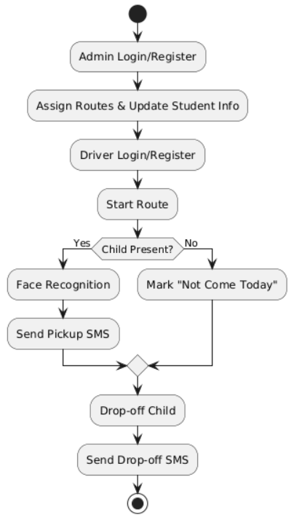
Methodology
GuardianSync leverages a comprehensive approach encompassing real-time GPS tracking, robust face recognition technology, and secure communication channels to enhance child safety.
For child registration, administrators input essential details such as the child's name, class, and parent information. A high-resolution photograph is captured during registration, which serves as the reference image for facial recognition. This image is securely stored in the database and used to verify the child’s identity during pickups.

Slide 6
Module: 1 Child Registration Module
The Child Registration Module provides a streamlined and secure process for enrolling children into the GuardianSync system. Administrators exclusively manage this module, ensuring all necessary details, such as the child's name, class, roll number, and parent’s contact information, are accurately recorded to create a comprehensive profile.
A crucial aspect of this module is capturing a high-quality facial photograph during registration, which serves as the reference image for the facial recognition system. This photograph ensures that only authorized individuals can pick up or drop off the child. All collected data, including personal and biometric information, is securely stored in the database, providing a reliable foundation for the system’s identity verification processes.

Slide 7
Module: 2 Real-Time Location Tracking
The Real-Time Location Tracking Module leverages GPS technology to ensure continuous monitoring of the vehicle’s location throughout its journey. This module enables accurate and reliable tracking by integrating GPS functionality directly into the mobile app, which continuously transmits location data to the backend system.
The real-time GPS updates are displayed on an interactive map within the parent’s web portal, offering a clear visualization of the vehicle’s live location. Parents can use this feature to monitor the vehicle’s progress and receive accurate estimated arrival times, allowing them to plan effectively and minimize waiting periods.

Slide 8



Module: 3 Facial Recognition
Secure Access
Ensures only authorized individuals can access critical information.
Enhanced Security
Provides an extra layer of protection for children's safety.
Accurate Verification
Minimizes the risk of unauthorized access or misuse.

Slide 9
Module: 4 User Authentication Module
The User Authentication Module implements a robust and secure system to manage access and permissions for different user roles. Using Role-Based Access Control (RBAC), the system ensures that drivers and parents have clearly defined permissions, allowing them to access only the features relevant to their roles. This separation of access enhances both usability and security.
Authentication is powered by JSON Web Tokens (JWT), which provide stateless and encrypted session management. JWT ensures secure login sessions without overburdening the server, maintaining a smooth and efficient user experience. For drivers, the system offers login access through the mobile app, enabling them to begin their assigned routes. Drivers can view child-related pickup and drop-off details while securely interacting with the system. Parents, on the other hand, use the web portal to log in and monitor real-time vehicle locations, track their child’s status updates, and follow the child’s journey seamlessly.

Slide 10
Module: 5 Pickup and Drop-Off Status Update
The Pickup and Drop-Off Status Update module focuses on managing child transit events with accuracy and security. Drivers use this module to update the child’s status as "Picked Up," "Dropped," or "Not Coming Today" in real time, ensuring seamless communication with parents and administrators.
This module relies on facial recognition to verify the child’s identity at pickup points, ensuring authorized handovers. Parents receive instant SMS notifications for each status change, keeping them updated about their child’s location and safety. By integrating real-time biometric verification, GPS tracking, and automated communication, this module minimizes errors, enhances transparency, and fosters trust among parents, schools, and drivers. Additionally, it streamlines daily transit operations and maintains precise records of all activities, reinforcing child safety during transit.

Slide 11
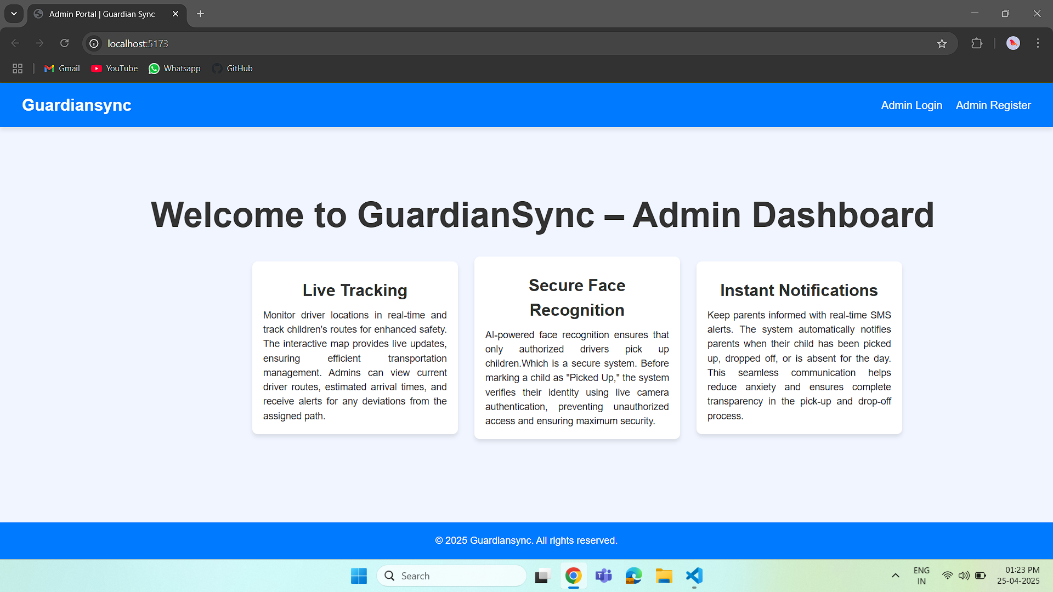
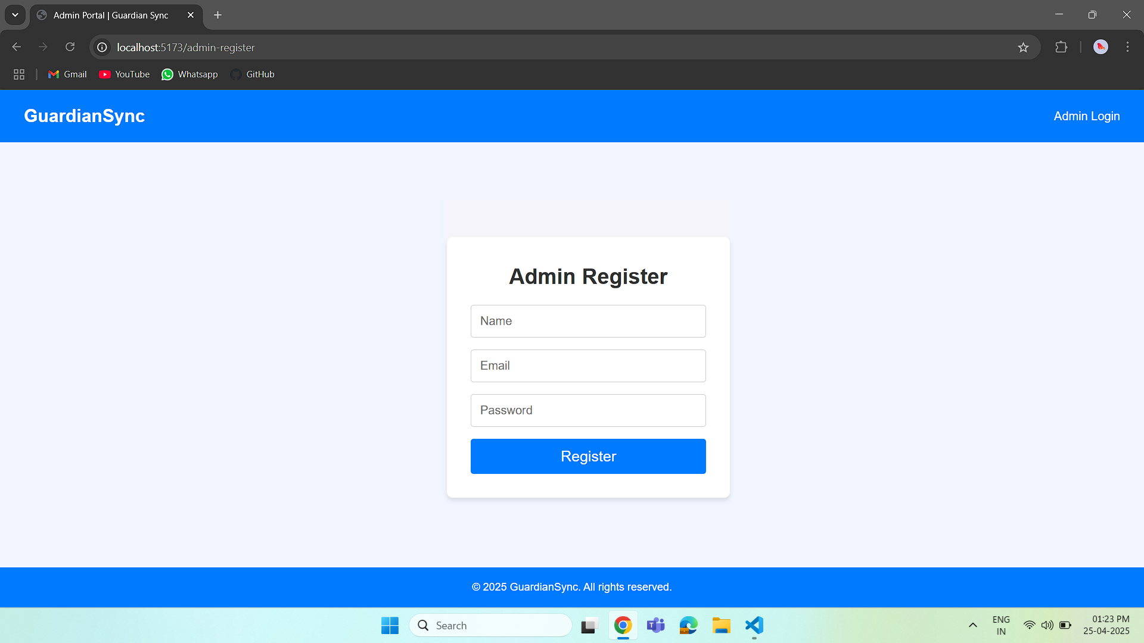
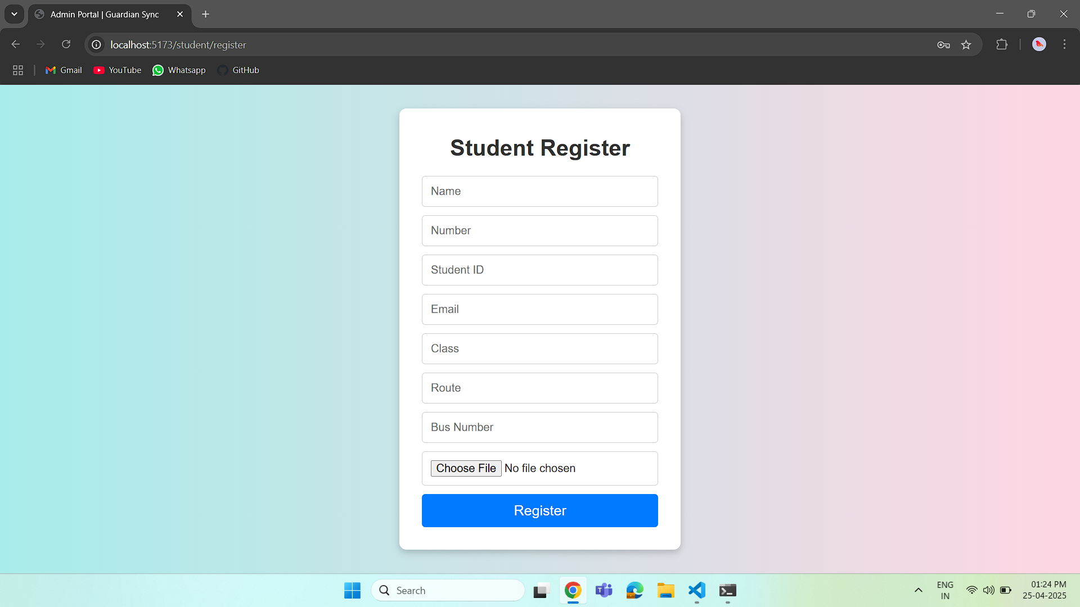
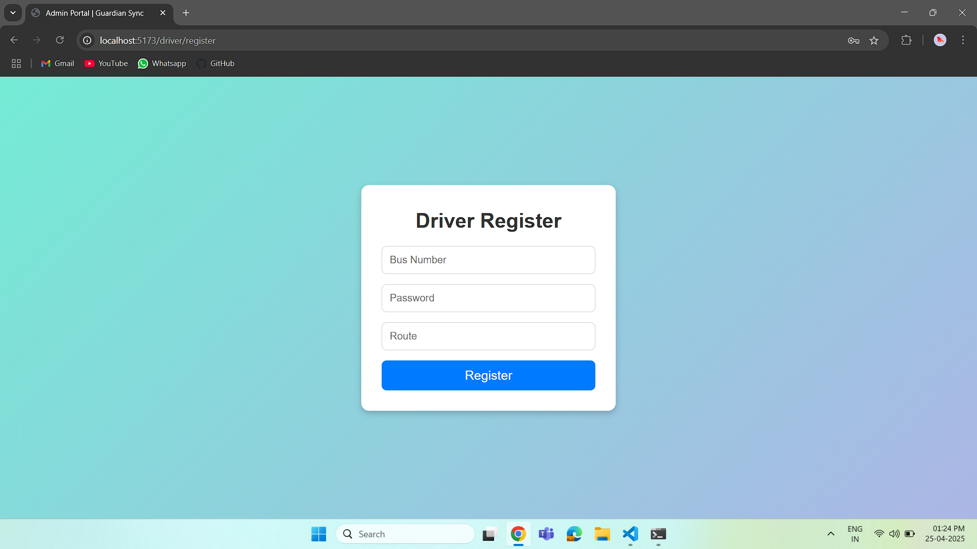

Slide 12
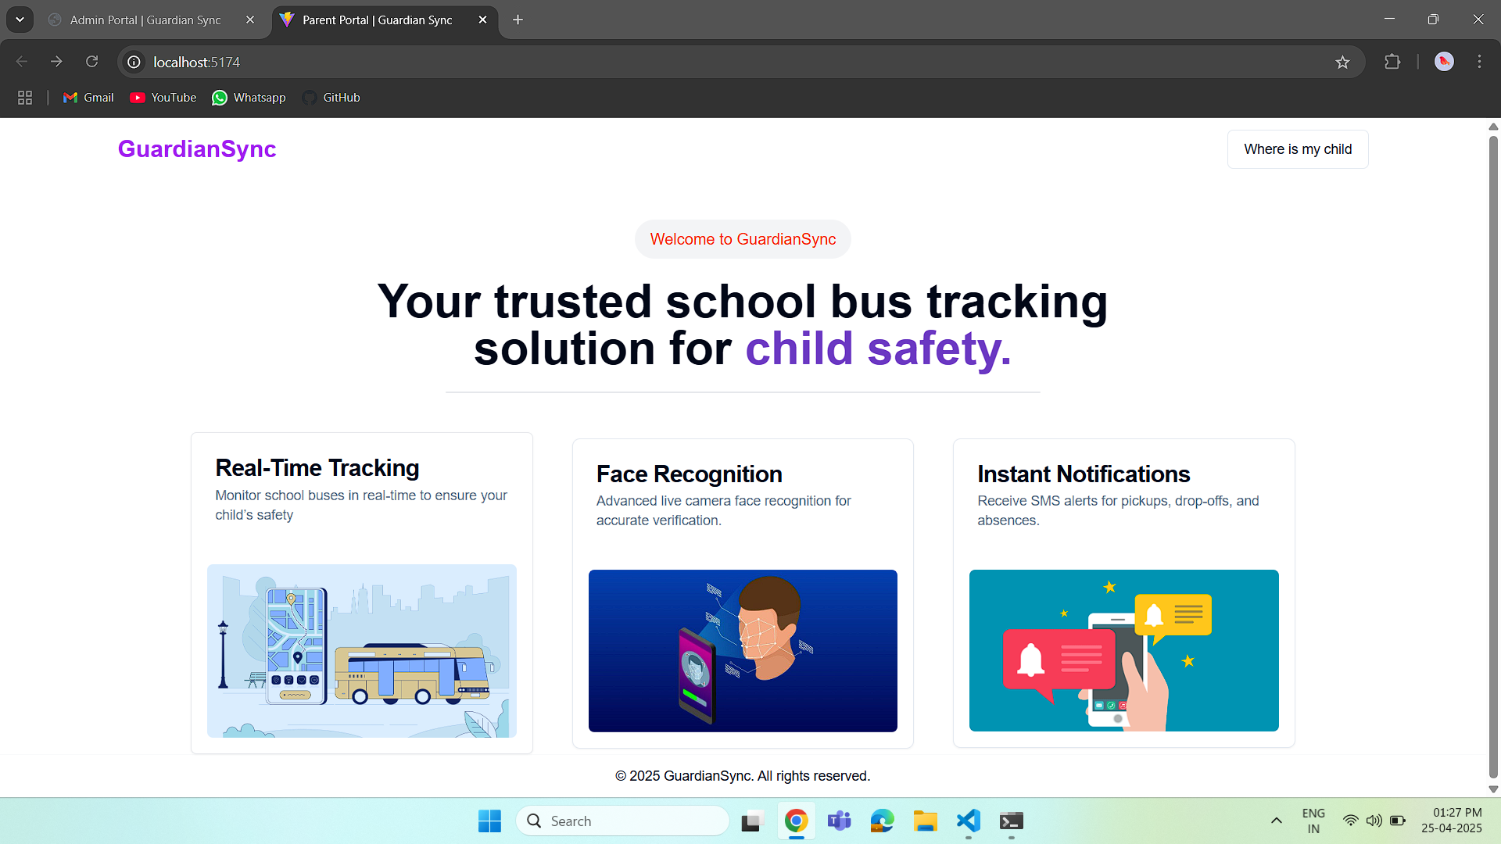

Slide 13
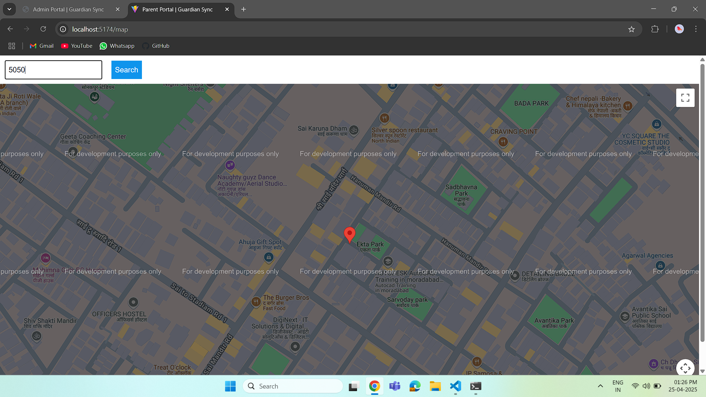
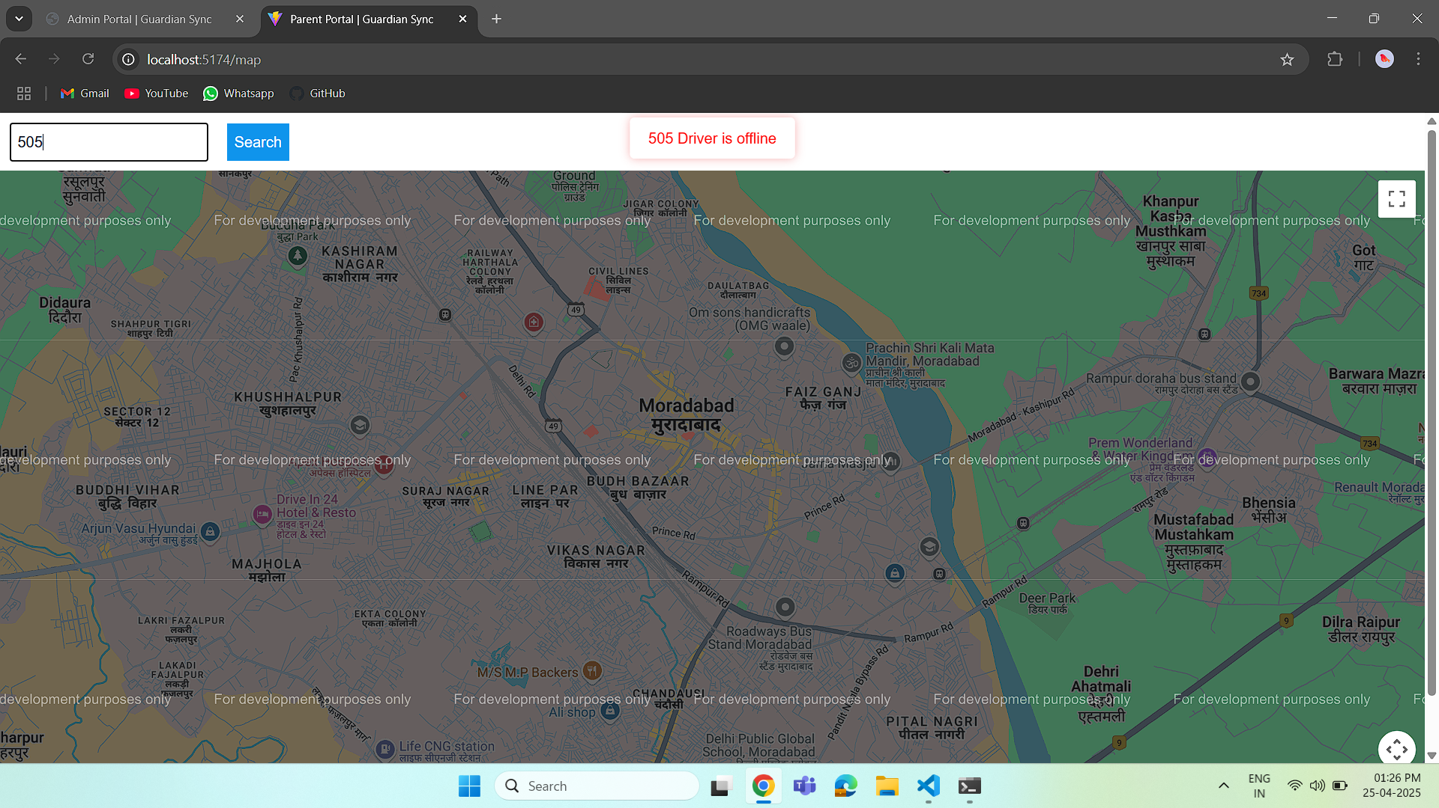

Slide 14
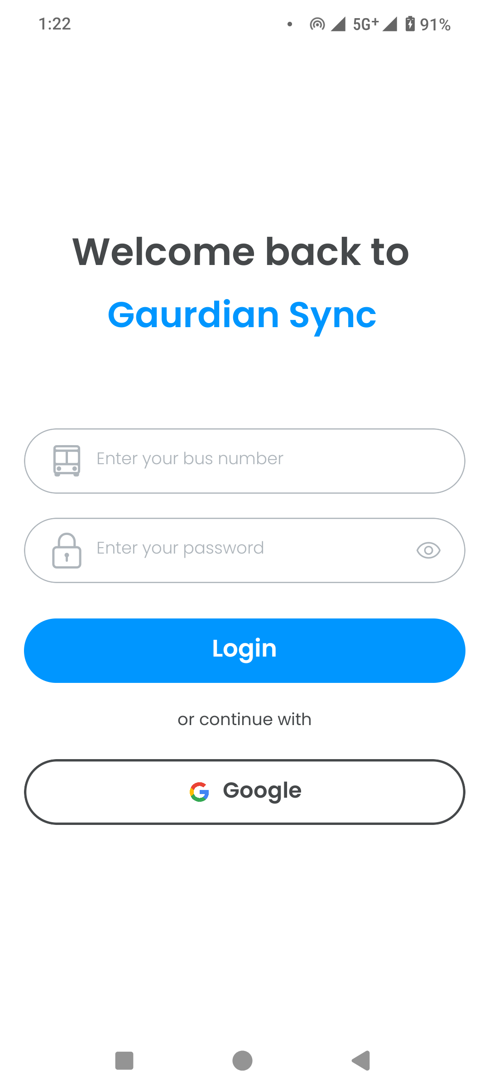
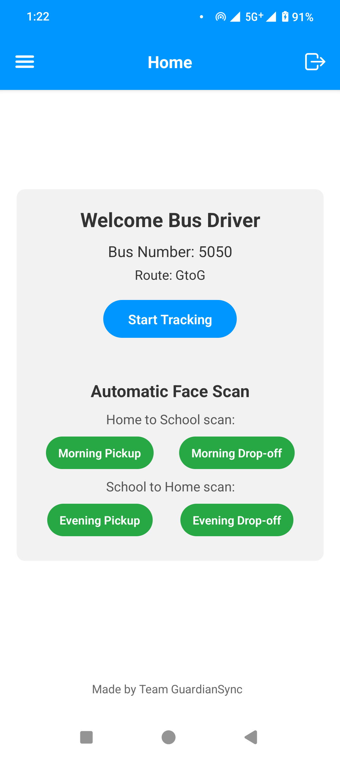
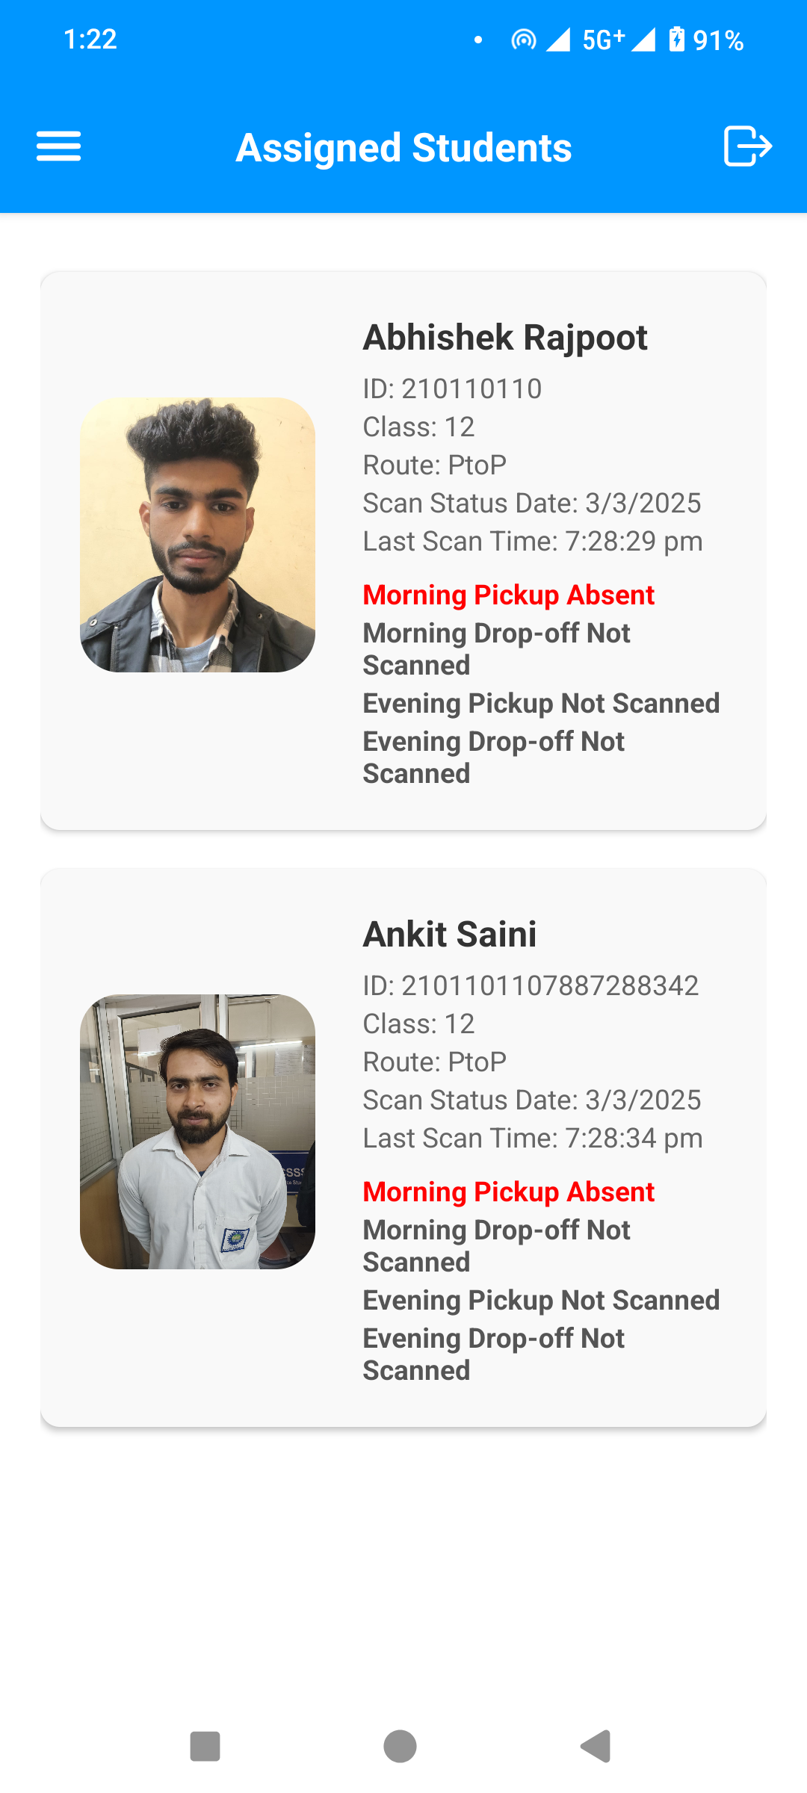
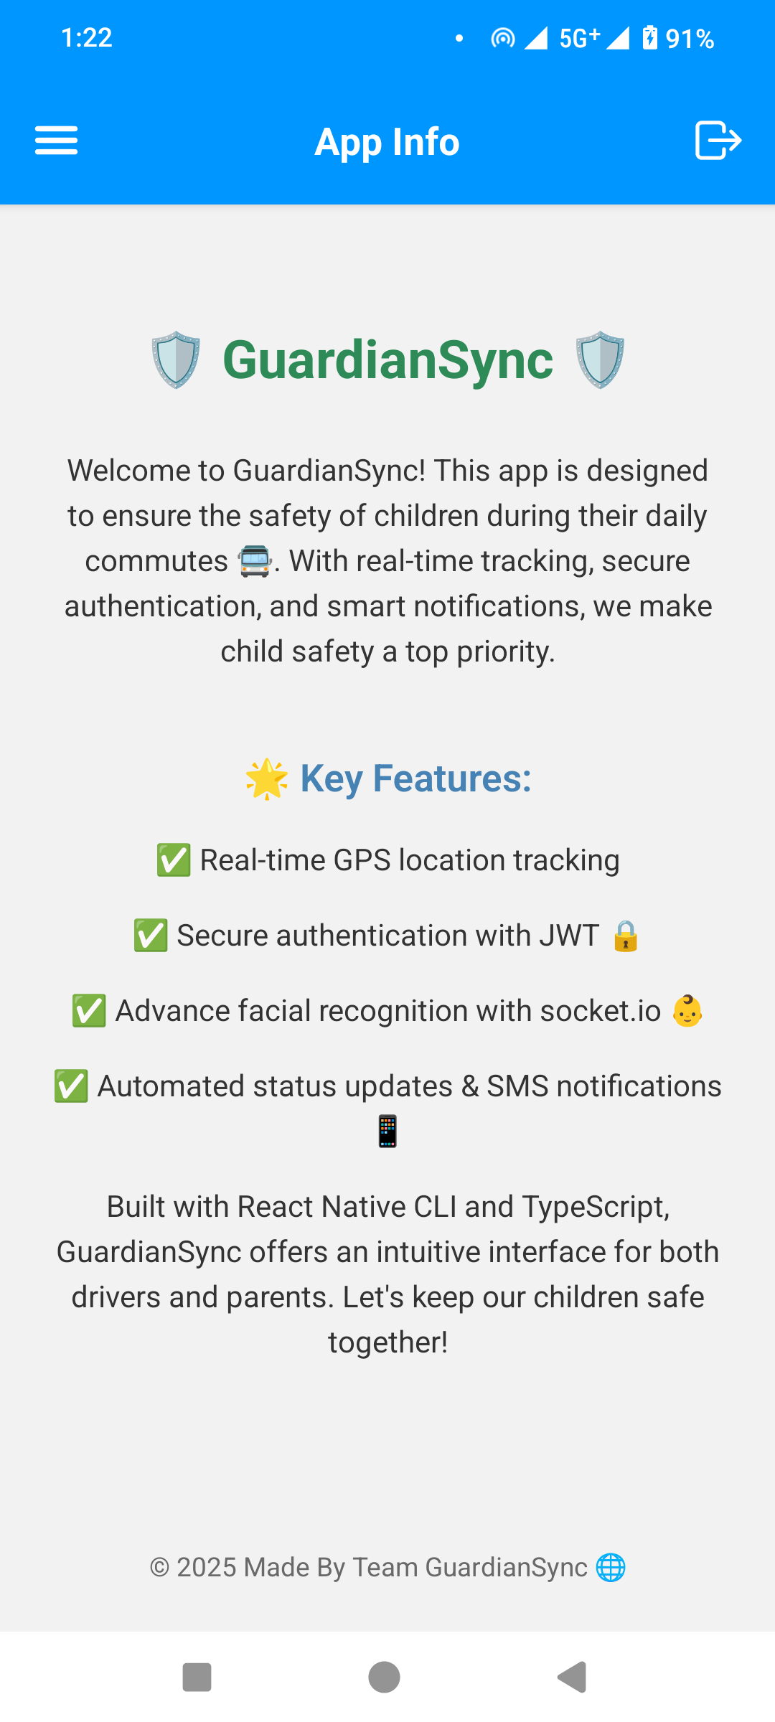

Slide 15
Results
The GuardianSync system demonstrated outstanding performance during testing, particularly in its core functionalities. The facial recognition module achieved a high accuracy rate of 95%, ensuring precise and reliable identification of children during pickups and drop-offs. This level of accuracy significantly enhances security by minimizing the risk of unauthorized pickups.
The real-time GPS tracking feature performed seamlessly, providing continuous updates with minimal latency. This allowed parents and administrators to monitor the exact location of vehicles throughout the journey, ensuring transparency and peace of mind. The integration of GPS data with the web portal enabled the display of live vehicle locations on an interactive map, offering a user-friendly and intuitive tracking experience.
These results underscore the system's reliability and effectiveness in addressing key challenges related to child safety and real-time monitoring, making GuardianSync a robust solution for its intended purpose.

Slide 16
FUTURE WORK
The Future Enhancements of the GuardianSync system focus on improving performance, accuracy, and overall user experience through advanced technologies and optimizations.
Enhanced Facial Recognition aims to address challenges caused by varied lighting conditions. By incorporating adaptive lighting adjustments and training the facial recognition model on more diverse datasets, the system will achieve higher accuracy and reliability, reducing false negatives in difficult environments.
Geofencing Implementation will add a new layer of monitoring by triggering location-based alerts when vehicles enter or exit predefined zones, such as schools or homes. This feature enhances safety by providing parents and administrators with real-time notifications about the vehicle’s movement in critical areas.

Slide 17
Thank You
GuardianSync offers real-time tracking, secure face recognition, and a user-friendly interface for parents concerned about their children's safety.

